Slide 1
Intro to Hacking and Programming
Level 0x00: The Shell

Slide 2
Quick Overview
Basic Programming
C (and C++)
Python
Scripting (bash)
Operating system concepts
User privileges
Networking
Memory
Software Security Concepts
Crypto / Hashing
Disassembly / Reverse Engineering
How are bugs in software turned into exploits

Slide 3

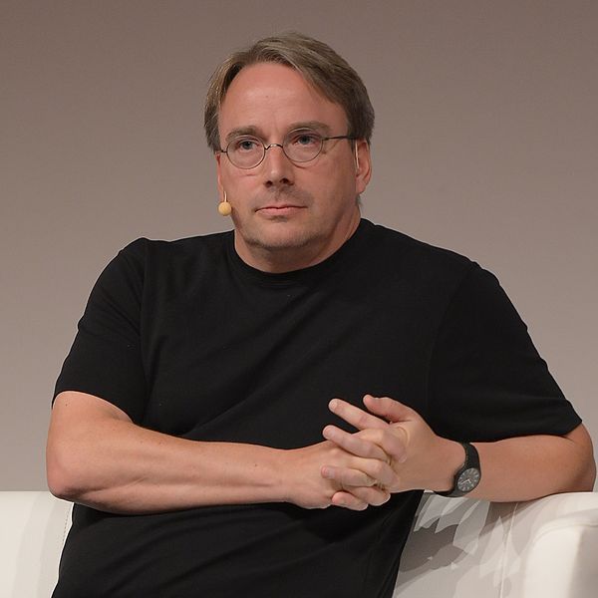
Operating Systems - UNIX-like
Unix
AT&T Bell Labs in 1970s by Ken Thompson, Dennis Ritchie, Brian Kernighan
Examples include: BSD, HP-UX, Solaris, SGI Irix
Multi-tasking, multi-user, programming tools included
Unix philosophy: “Write programs that do one thing and do it well”
OpenBSD / FreeBSD
University of California Berkeley open sources their Unix - permissive license
Also used by Mac OS, iOS, Playstation 3 (and newer)
Linux
Created by Linus Torvalds, first posted to Usenet in 1991
RedHat, Suse, Debian, Ubuntu, Android

Slide 4
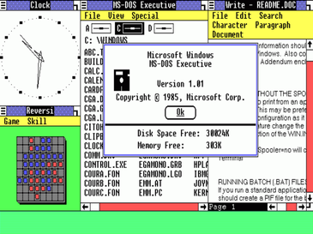
Operating Systems - Windows
MS-DOS
Main PC operating system in the 80s
One application at a time
8.3 filenames
Windows (DOS Application)
Multiple applications
Resizable GUIs, Networking
Windows 95/NT
Became core operating system
Long filenames
Start menu
32-bit Only

Slide 5
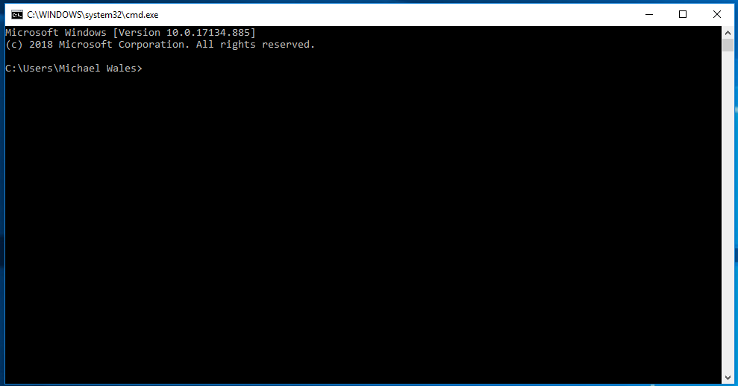
Windows Shell Basics
Windows Basic Shell
Press Win+R to bring up Run dialog
Type cmd to open shell
Functional, but very basic
Windows Alternative Shells
Powershell
WSL (Windows Subsystem for Linux)
WSL2

Slide 6
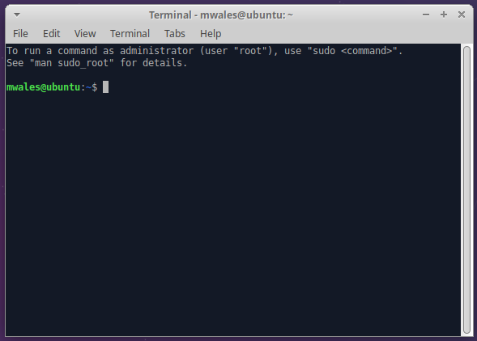
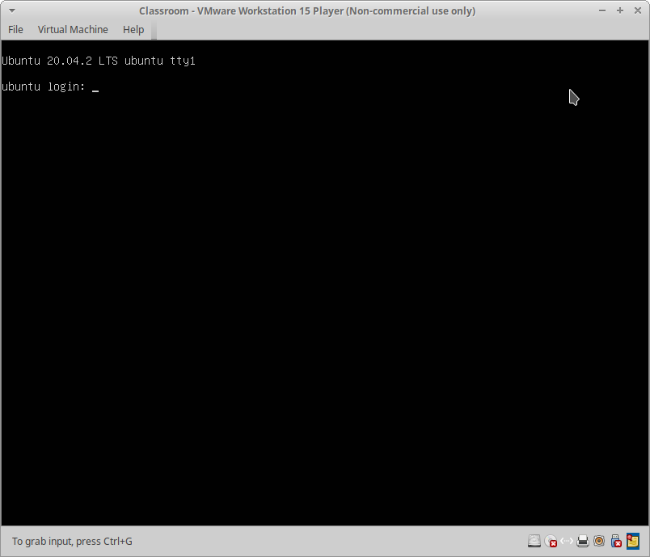
Linux Shell Basics
Bourne Shell (sh): Standard old-school shell for Linux and Unix systems
Alternative shells:
bash, dash: Very similar, more features
csh, tcsh, ksh, zsh, probably more…
Many ways to access the shell
GUI Shell Program (Terminal)
/dev/tty1 text console
CTRL+ALT+F1 (through F6 typically)
CTRL+ALT+F7 restores GUI
Serial port
Remotely via SSH (or Telnet)
Notes:
Many different shells for Unix, I typically just use whatever the distro comes with
Unlike Windows shell which is a GUI program for entering text, Linux shell is both an interpreter (sh) and a way to access it (Terminal, SSH, serial)
Drop down shells like guake (give shell via a hotkey)
Grand prize for a hacker is to get a shell on remote system (it’s incredibly powerful)
Class will focus on Linux shell
In VmWare, CTRL+ALT+SPACE, then hit F1-F12

Slide 7
Filesystem
Filesystem is usually a directory of files on your SSD / hard disk
Windows: C: D: (drive letters)
*nix: / /mnt /media/cdrom
Each directory can have thousands of files and other directories
Command | Explanation
pwd | Present working directory
ls | List contents of a directory
Notes:
Filesystems on Linux don’t necessarily map to a disk
/proc and /sys are special directories that display kernel information
/tmp traditionally a RAM filesystem
/dev devices on Linux

Slide 8
Directory Commands
Command | Explanation
mkdir DIRECTORY | Makes a new directory
cd DIRECTORY | Changes to a subdirectory
cd .. | Changes to the parent directory
rmdir DIRECTORY | Removes a directory (must be empty)
tree | Lists all files / subdirectories

Slide 9
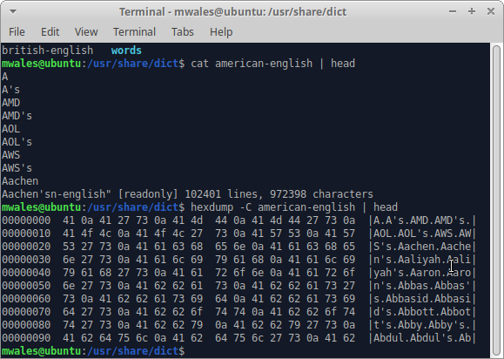
Files
Common contents of a file
Text
Executable Programs
Databases (SQL)
Compressed Archive
Images
Word document
Compressed Archive
Text
Images

Slide 10
File Commands
Command | Explanation
touch FILE | Creates a blank file
cat FILE | Displays contents of a file
head FILE | Displays beginning of a file
tail FILE | Displays ending of a file
hexdump FILE | Displays contents of a binary
file FILE | Tells you what type of a file

Slide 11
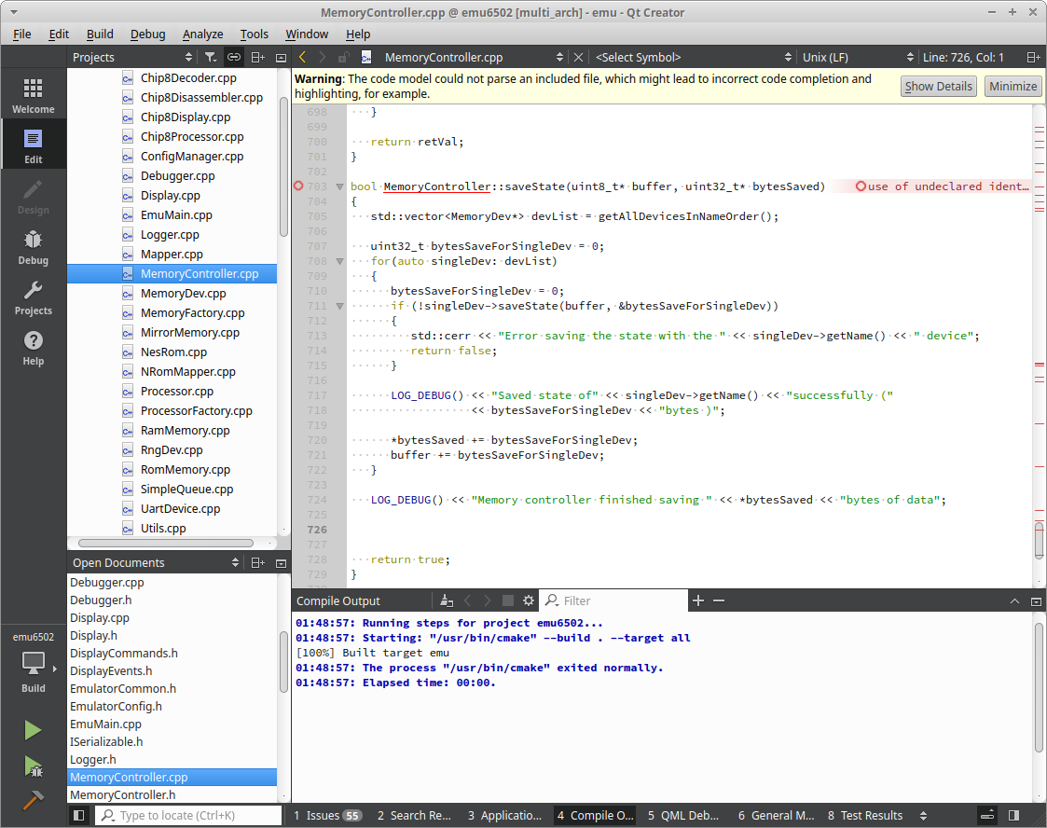
Editors
GUI
Simple: write text, save to a file
Gedit, Mousepad, Notepad
Coding: automatic coloring, auto-complete
Geany
Sublime ($)
Atom
IDE: integrated development environment
Qt Creator
Visual Studio
CLion
Command Line
vi / vim, emacs
nano, pico
Notes:
Coding: editors will usually allow you to help style code (indentation, braces). Usually works with many languages
IDEs have tools integrated for debugging, code analysis, GUI development. Sometimes only 1 language or platform is focused on.
vi vs emacs is religious debate among grey beards

Slide 12
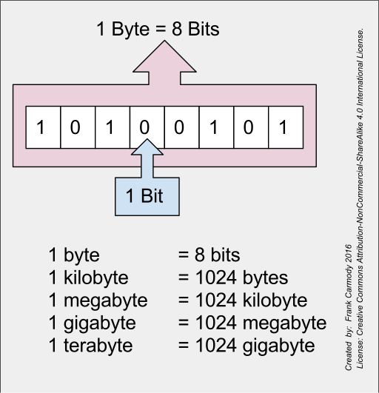
Bits / Bytes
Bit: Either 0 or 1 (binary)
Bytes: 8 bits (uint8_t)
00000000 = 0
11111111 = 255 = 0xff
2 possible states for 8 bits = 2⁸
Bigger Numbers via more bits.
2¹⁶ = uint16_t = 65,536
2³² = uint32_t = 4,294,967295
Negative numbers (Signed Integers) int8_t
Highest bit is a sign bit
2’s complement
Floating Point (32-bit and 64-bit)
Notes:
U in uint8_t means unsigned (all positive)
Negative numbers.
If high bit is 1, means it’s negative
2s complement beyond scope of this class

Slide 13
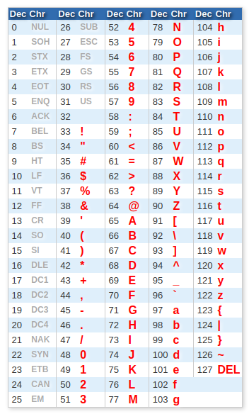
ASCII Encoding
ASCII encoding: Mapping of number 0 - 127 to characters
1-byte for each character
1st bit of ASCII always 0 (less than 128)
Some of the 128 are non-printable
10 = newline “\n”
7 = bell
127 = delete
Other encoding
UTF-8, UTF-16, UTF-32
Emoji

Slide 14
File Commands
Command | Explanation
strings FILE | Prints out printable strings of a binary file
sort [FILE] | Prints lines in alphabetical order
uniq [FILE] | Removes redundant lines out output
wc [FILE] | Counts number of words in a file
dos2unix / unix2dos [FILE] | Converts file line endings
more / less [FILE] | Shows output 1 page at a time
grep needle [FILEs] | Searches for a string
Notes:
Word count can count number of lines too
Less name: because less is more

Slide 15
Standard Input / Output
3 file descriptors open by CLI application
0 = stdin (standard input)
1 = stdout (standard output)
2 = stderr (standard error)
Pipes ( | ) can be used to connect output from one application to input of another application
strings somefile | grep -i password
cat logfile | sort | unique

Slide 16
I/O Redirection
Using “> file.txt” after a command causes output from stdout to be redirected into a file
You won’t be able to see it on screen
stderr will still be displayed
Using “2> file.txt” after a command causes stderr to be redirected into file
Using “> file.txt 2>&1” causes both to be redirected
Order matters!
tee will write standard output to a file and also write it to the screen
Ex: ./myprogram arg1 arg2 | tee logfile.txt
>> will append to existing file, > overwrites it

Slide 17
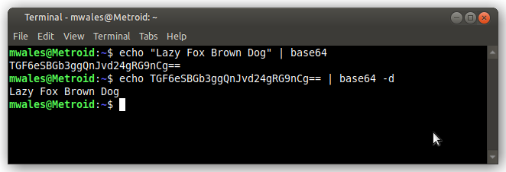
base64
A byte represents 0 - 255.
Printable ASCII is 32 - 127 (94 characters)
base64 uses 64 characters (6 bits)
A-Z a-z
0-9
+ /
= (padding, it’s always at the end)
You can use base64 to encode binary data into printable text (3 binary bytes -> 4 base64 characters)
Uses
Email attachments
Dumping a binary file out via serial shell
Simple obfuscation
base64 -d decodes base64 back into binary/ASCII

Slide 18
Shell scripts
A series of commands in a text file
Linux
Can start text file with #! (shebang) and make executable
Can call interpreter directly
Windows
.bat (batch) files
Windows Power Shell
Can take arguments ($1, $2)
Number of arguments ($#)
Command Substitution (not just for scripts)
echo “There are `ls *.txt | wc -l` files in this directory”
echo “There are $(ls *.txt | wc -l) files in this directory”

Slide 19
Basic Networking
IP4 Address
32-bit number
4 octects 0-255, example: 192.168.1.101
Port Number
0 - 65535
Ports 0-1023 are special, require root to listen on
Secure Shell (SSH)
Usually listens on port 22
Allows remote shell access via name/pass, or name/encryption-key

Slide 20
Netcat / Socat
Utilities to listen/connect to TCP/UDP sockets
Netcat (nc): old / many implementations
socat: newer, can do encryption, files
Netcat chat
Server
nc -l -u 1337
Listens for UDP
Client
nc -u remote_ip 1337
Connects to UDP server
Create a remotely accessible shell
socat tcp4-listen:1337 exec:/bin/sh
Notes:
Can do shell with nc too, uses a pipe in some versions (Ubuntu default):
mkfifo /tmp/f
cat /tmp/f | /bin/sh -i | nc -l 6969 > /tmp/f

Slide 21
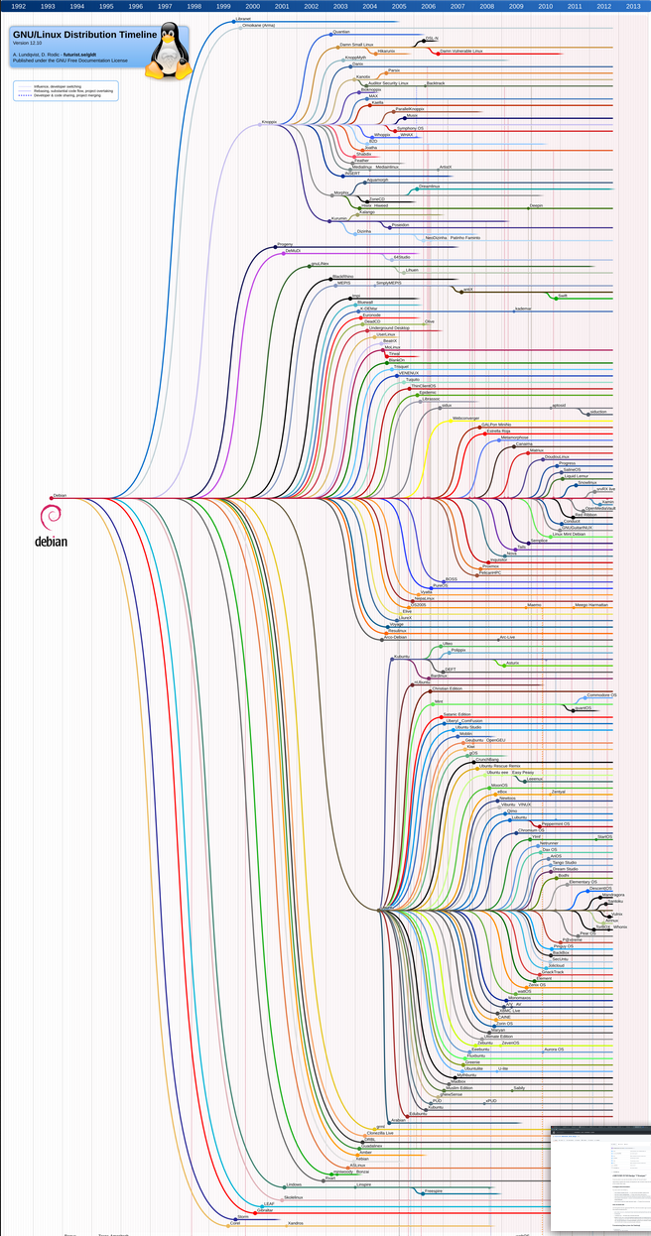
Ubuntu
Child / Fork of Debian Linux
Ubuntu provides:
Software repository with > 20,000 packages (apps, libraries)
Apt package manager
Installs new packages
Updates packages
Removes packages
Ubuntu has many flavors
Which desktop manager used by default
Which applications used by default
Custom theming
Releases every 6 months
LTS every 2 years. 22.04 is current LTS

Slide 22
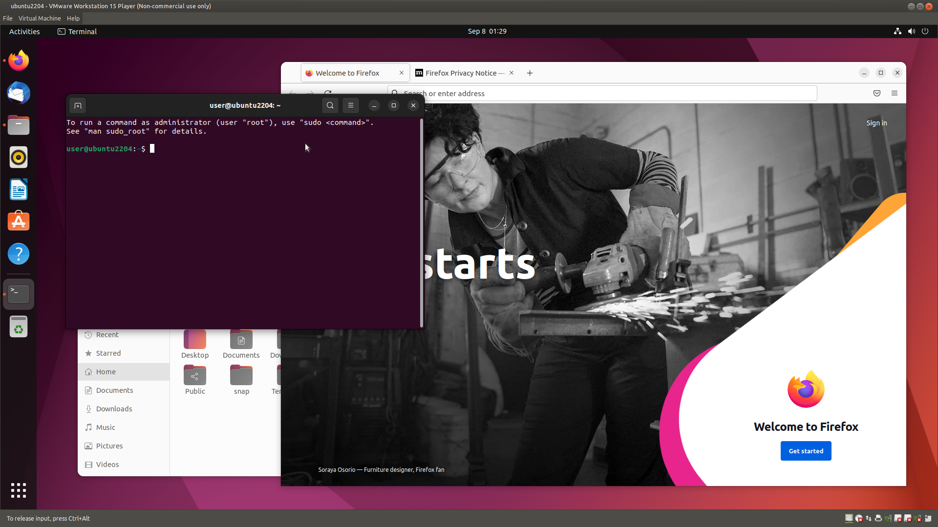
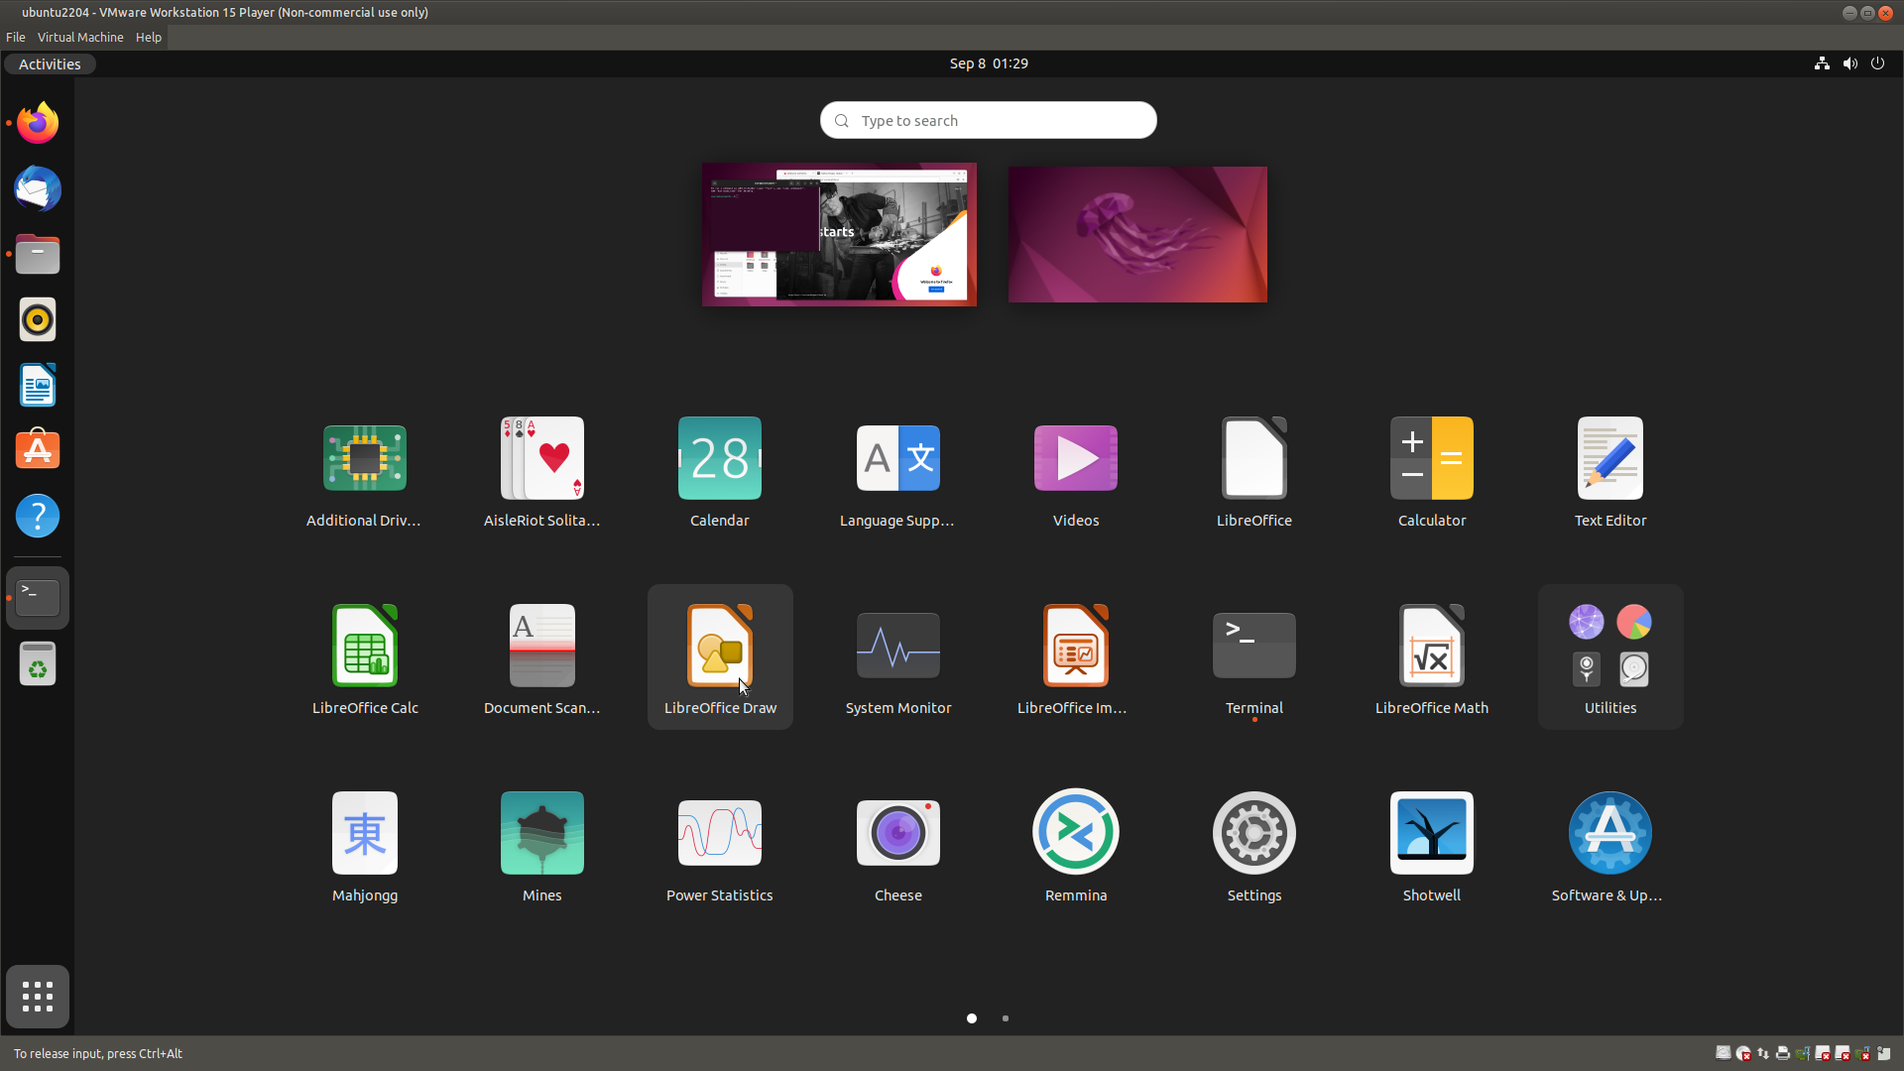
“Vanilla” Ubuntu

Slide 23
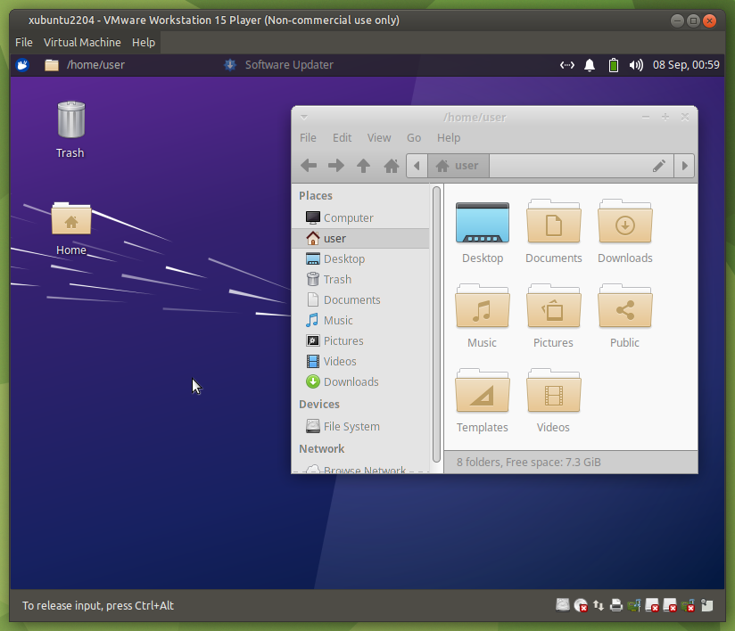
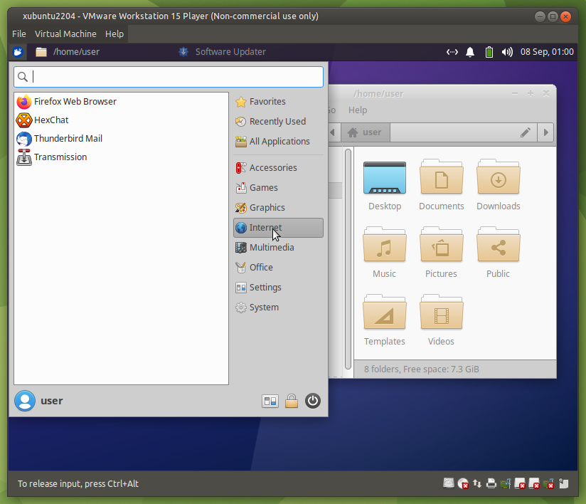
Xubuntu

Slide 24
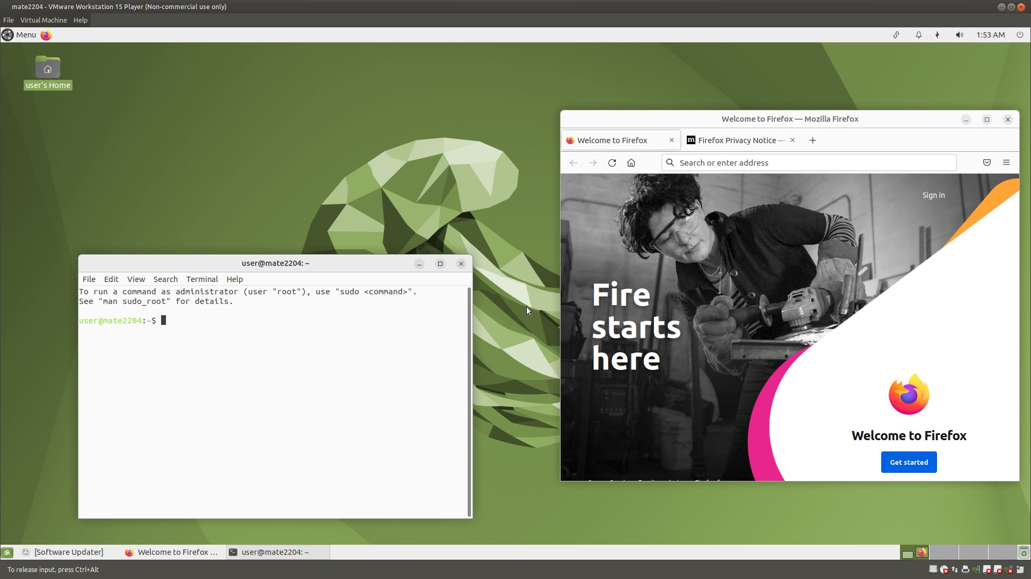
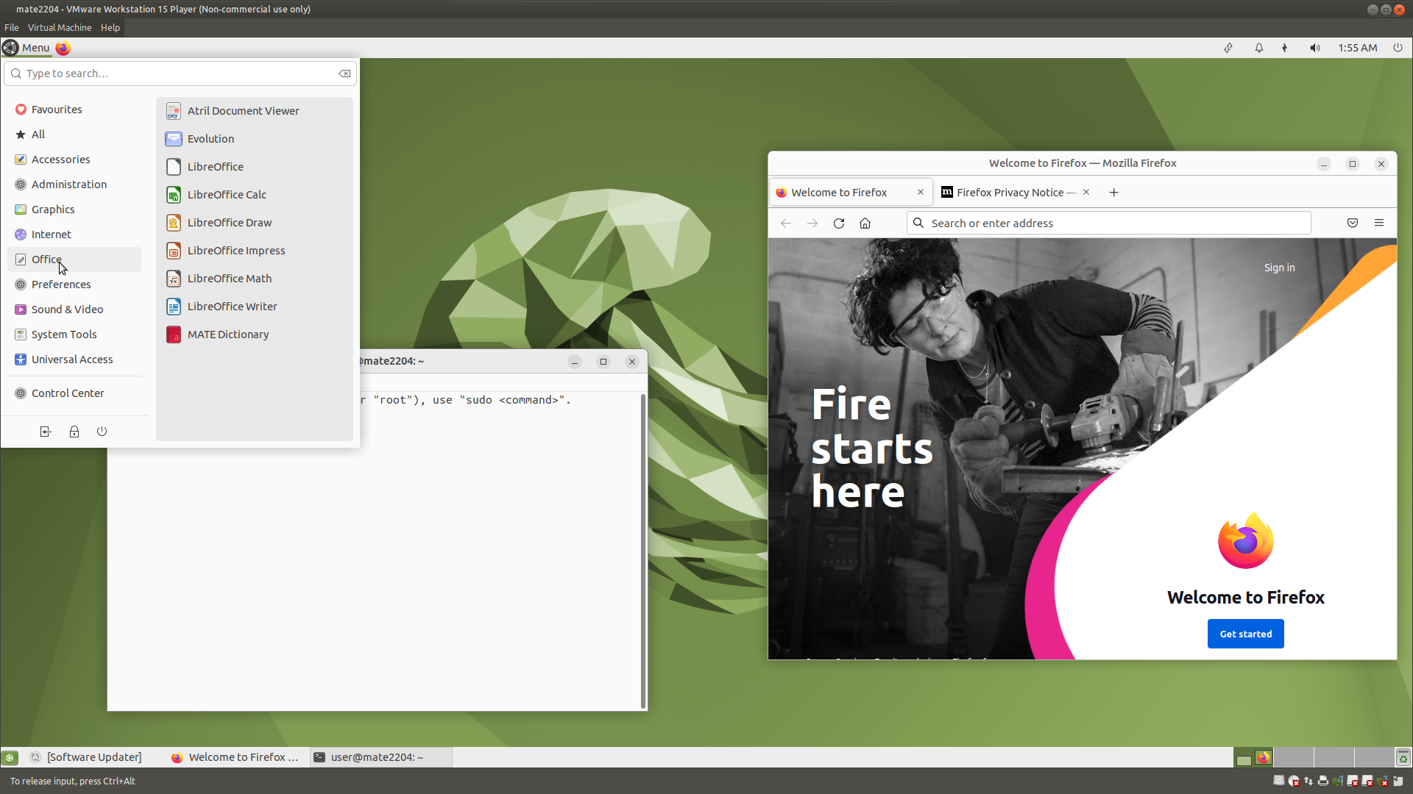
Ubuntu MATE

Slide 25
Attributions
Ken Thompson and Dennis Ritchie: from Wikipedia, public domain
Linus Torvalds: Wikimedia Creative Commons Attribution-Share Alike 3.0
Windows screenshot: https://en.wikipedia.org/wiki/File:Windows1.0.png
Bits/Bytes: Frank Carmody
Debian Family Tree: Andreas Lundqvist, Donjan Rodic from wikimedia.org

